Slide 1

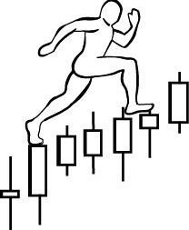
Homework #6-1:
Exercise: VSA
Assignment: Visualize all VSA concepts (1-10) on any chart
www.WyckoffAnalytics.com Copyright © 2019 Wyckoff Associates, LLC. All Rights Reserved.

Slide 2
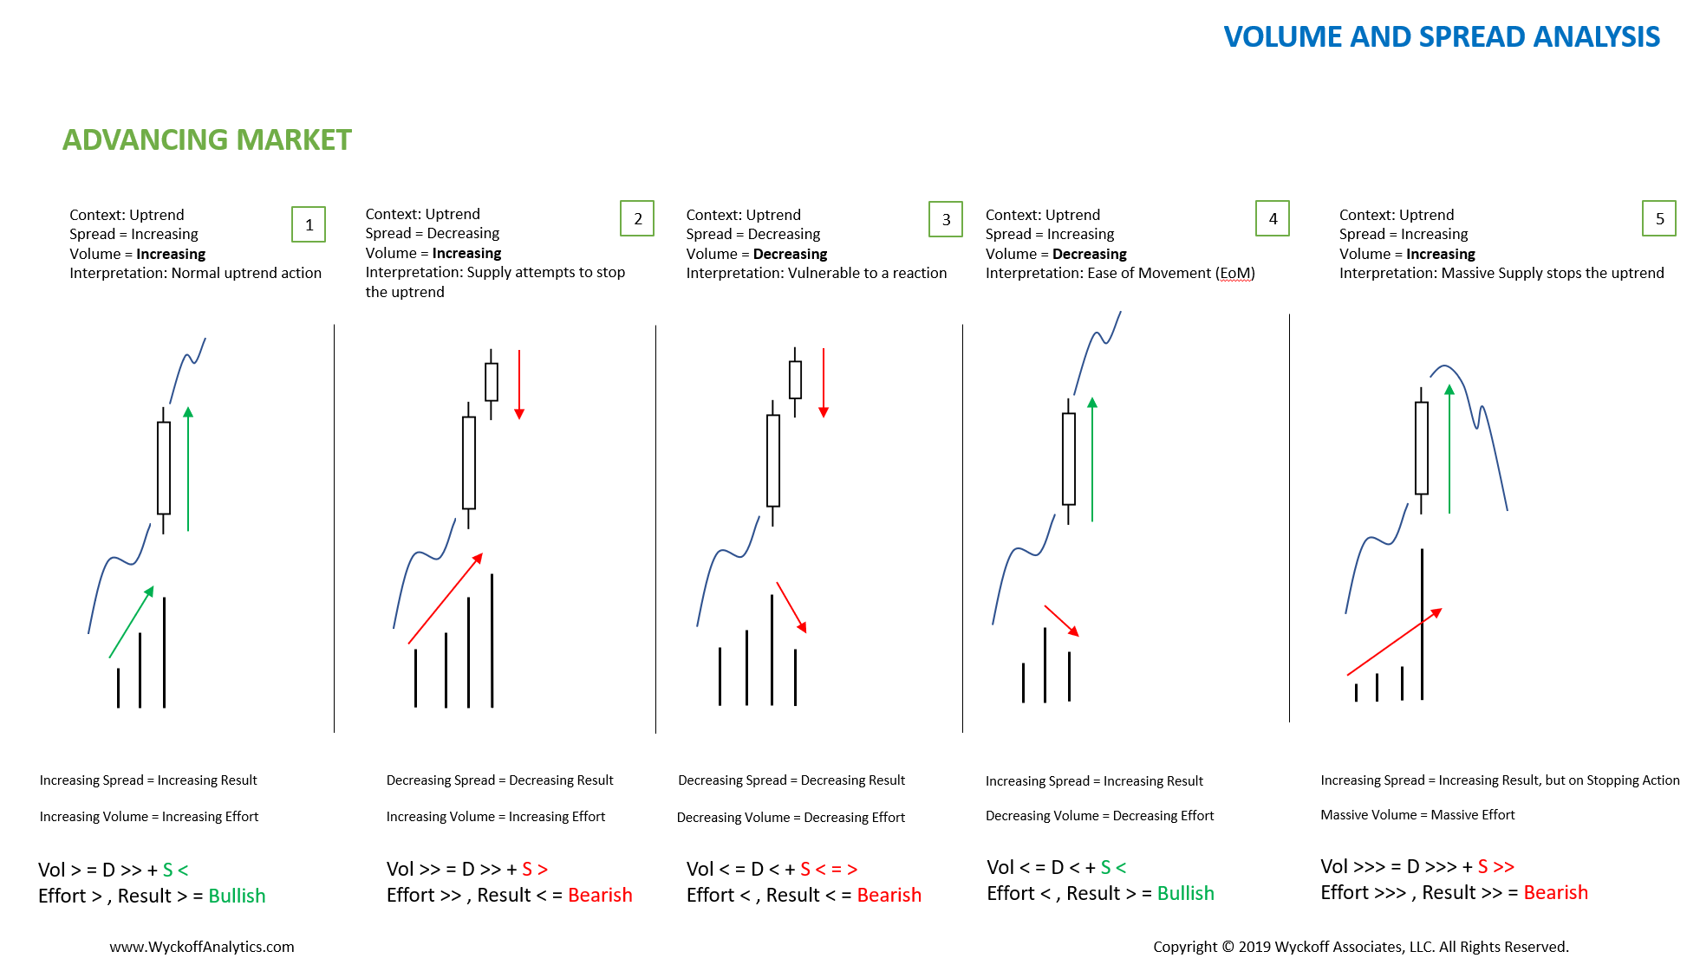

Slide 3
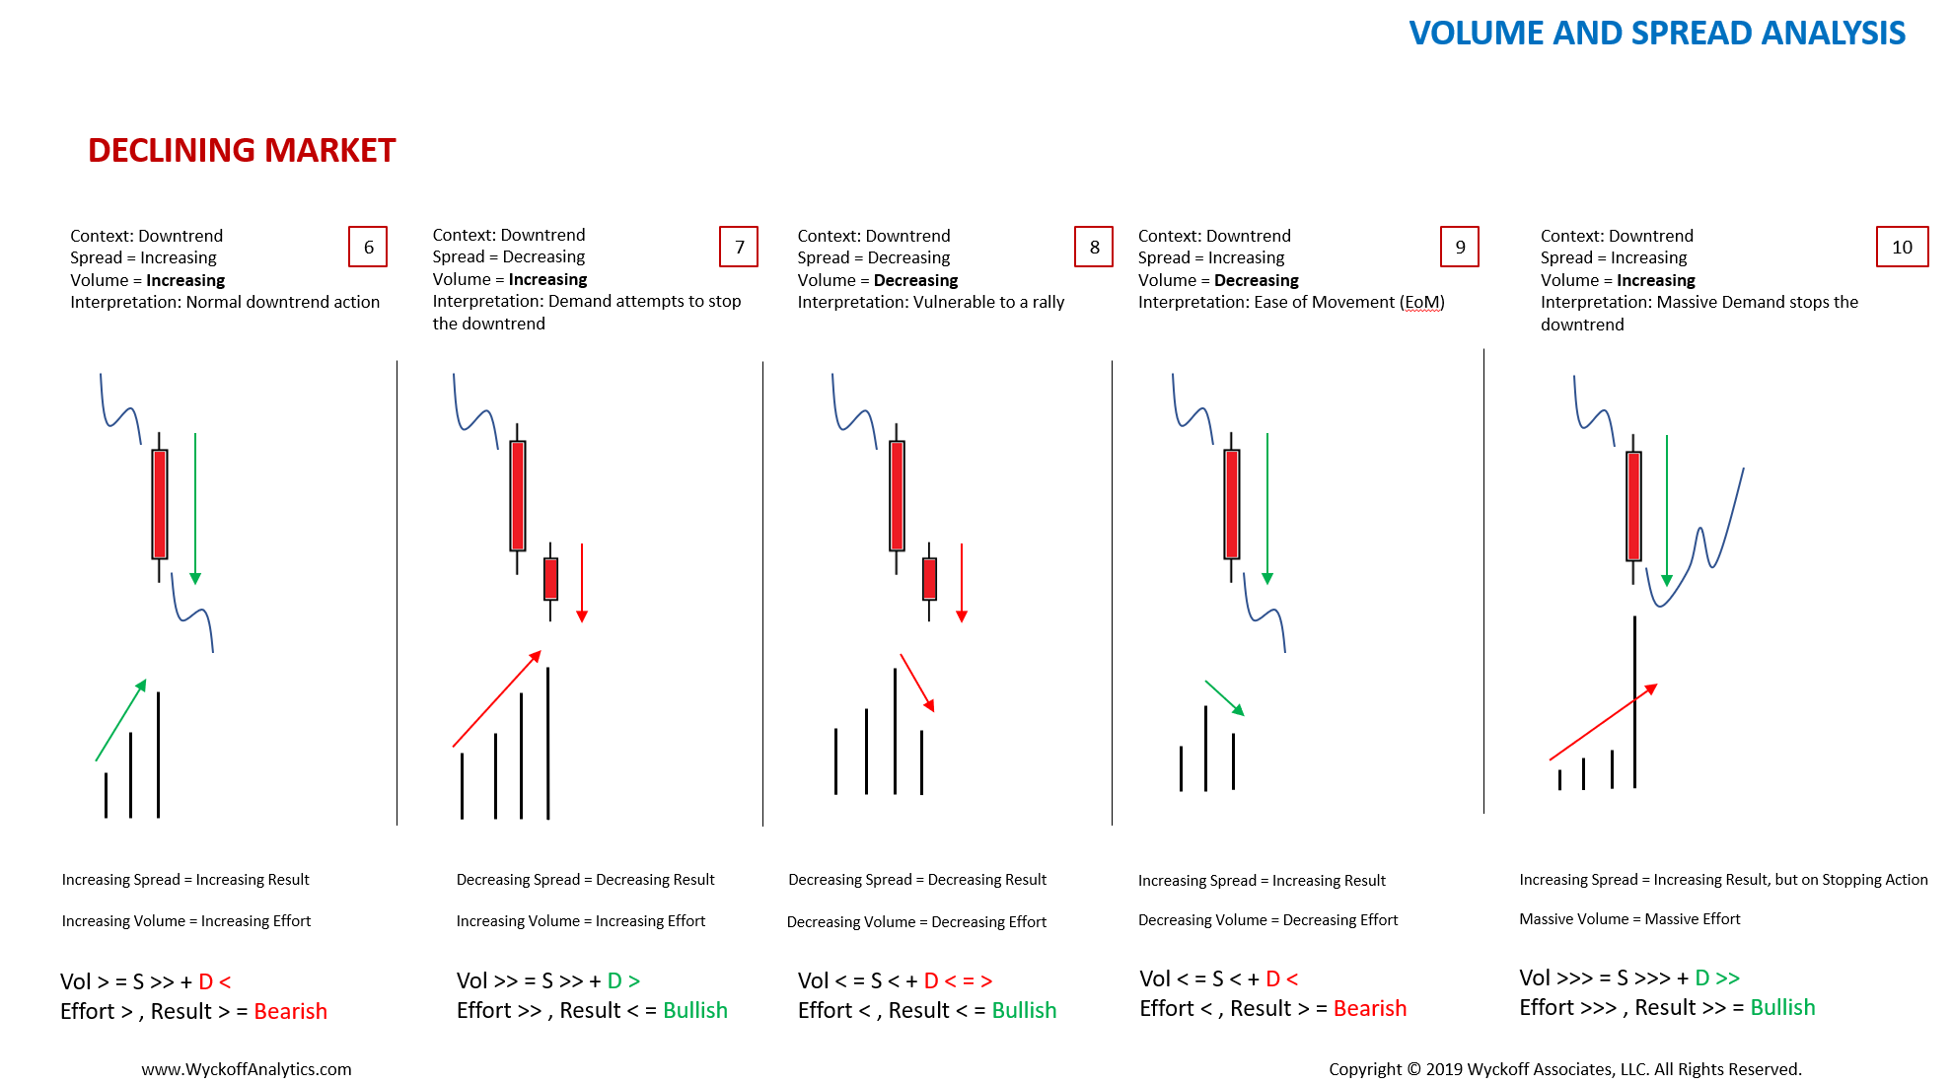

Slide 4
Group Exercise
and
Homework #6-2:
Exercise: Volume and Price Analysis
Price Structural Analysis
Assignment:
Identify the dominance of Supply or Demand on a single bar or a swing
Combine Price Structural Analysis with Volume Analysis
Make your determination about the next most probable price action
Label trading ranges with Wyckoff Phases and events
Watch the video of this exercise again and make notes. Email the notes to Roman.
www.WyckoffAnalytics.com Copyright © 2019 Wyckoff Associates, LLC. All Rights Reserved.

Slide 5
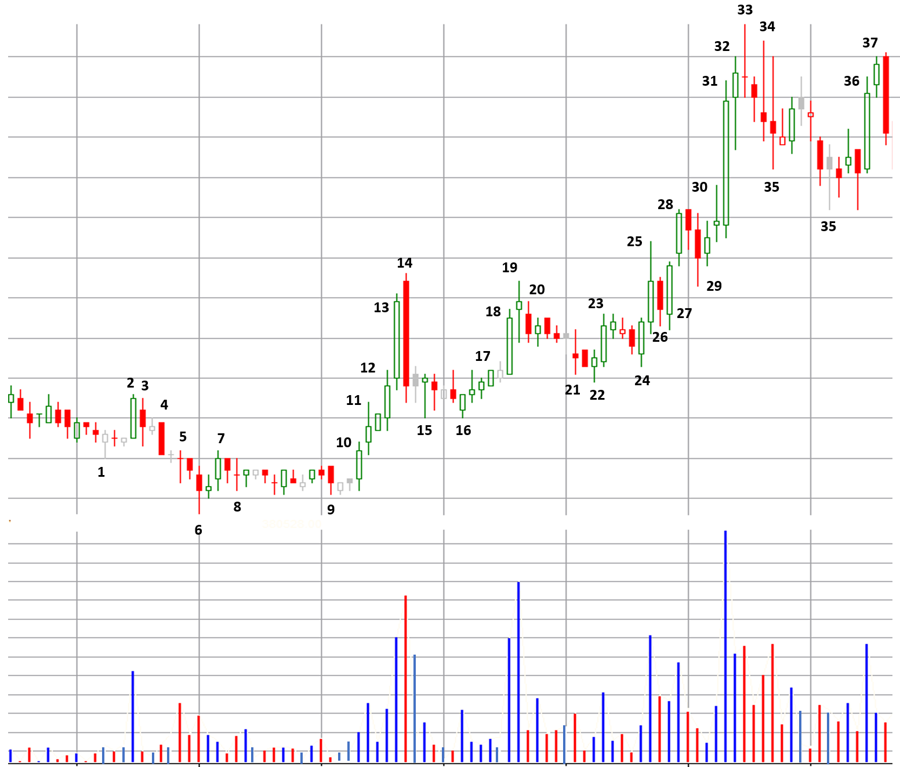
Swing #10
Group Exercise - 1
Swing #12
BAR # ANALYSIS
Effort Volume
Demand
Supply
Dominating Effort
Result Spread Close-to-spread: Close-to-close:
Intention (up/down):
Analogue bar(s)
Swing #6
Swing #8
Swing #11
SWING # ANALYSIS
Previous swing of the same bias
Previous swing of the counter bias
Market Behavioral Analysis (Strong/Weak Hands)
CO types:
ITF types:
Professionals:
Public:
FINAL DEDUCTIONS
BIAS
Short-term:
Long-term:
TIMING
CHARACTER
Distance
Target zones
Momentum
Duration
Additional notes:
Swing #2
Swing #4
Swing #9
Swing #7
Swing #1
Swing #5
Swing #3
www.WyckoffAnalytics.com Copyright © 2019 Wyckoff Associates, LLC. All Rights Reserved.

